Slide 1


The Rotary Foundation
Turning Generosity into Impact
Kathleen Stoup, District 7390 Rotary Foundation Chair
Title Page Option

Slide 2
The Rotary Foundation helps Rotarians do good in the world – and in our own communities.
Every gift helps expand what Rotary clubs can accomplish.
How can we inspire more Rotarians to participate?
Title Page Option
Notes:
Today we want to talk about connecting your members with the impact their giving makes possible.

Slide 3
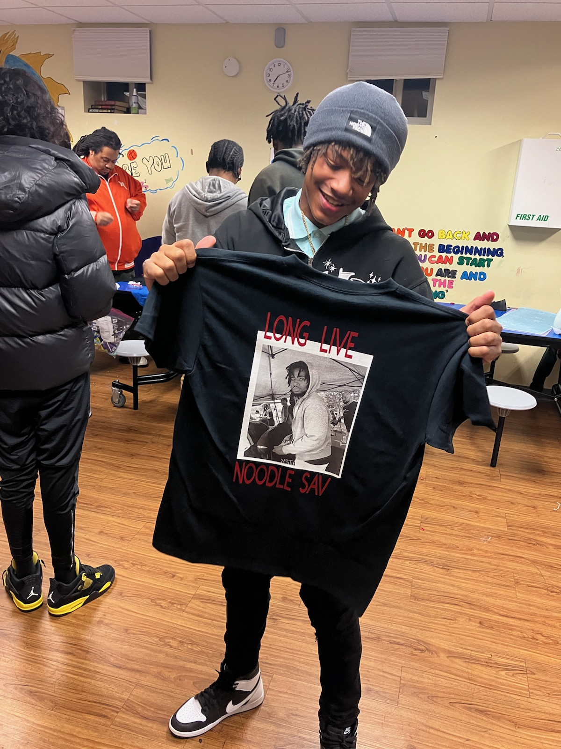
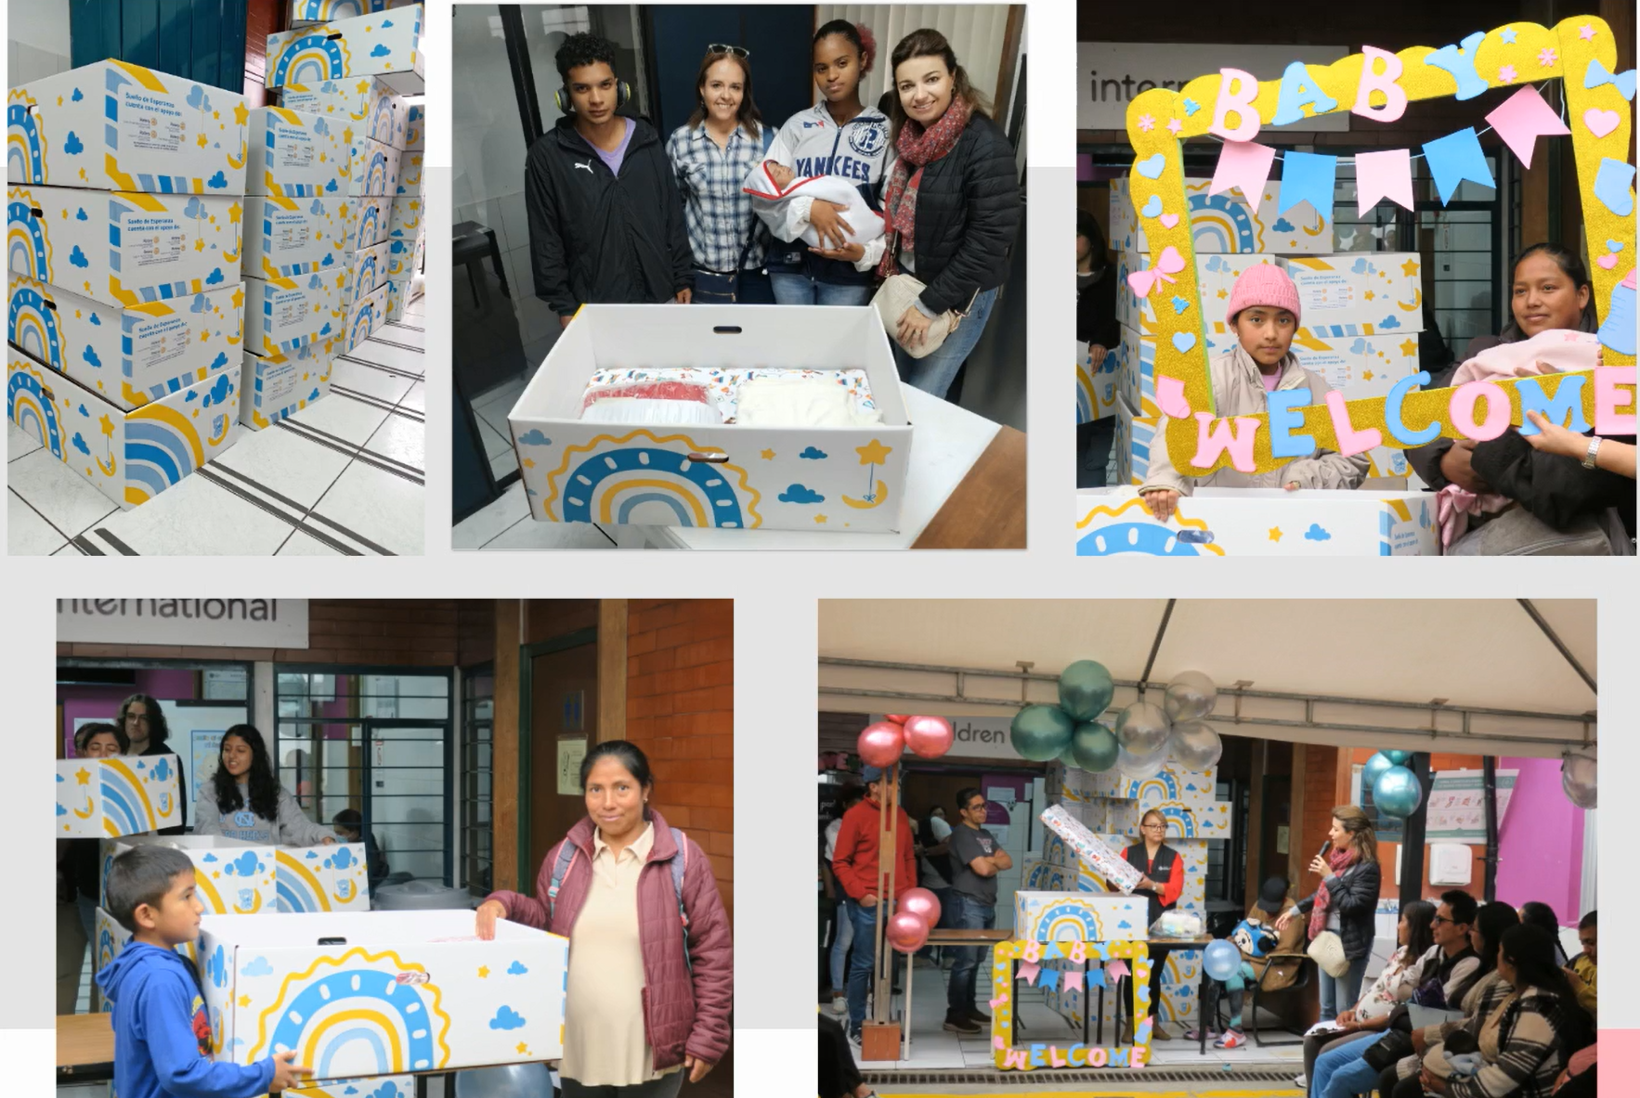
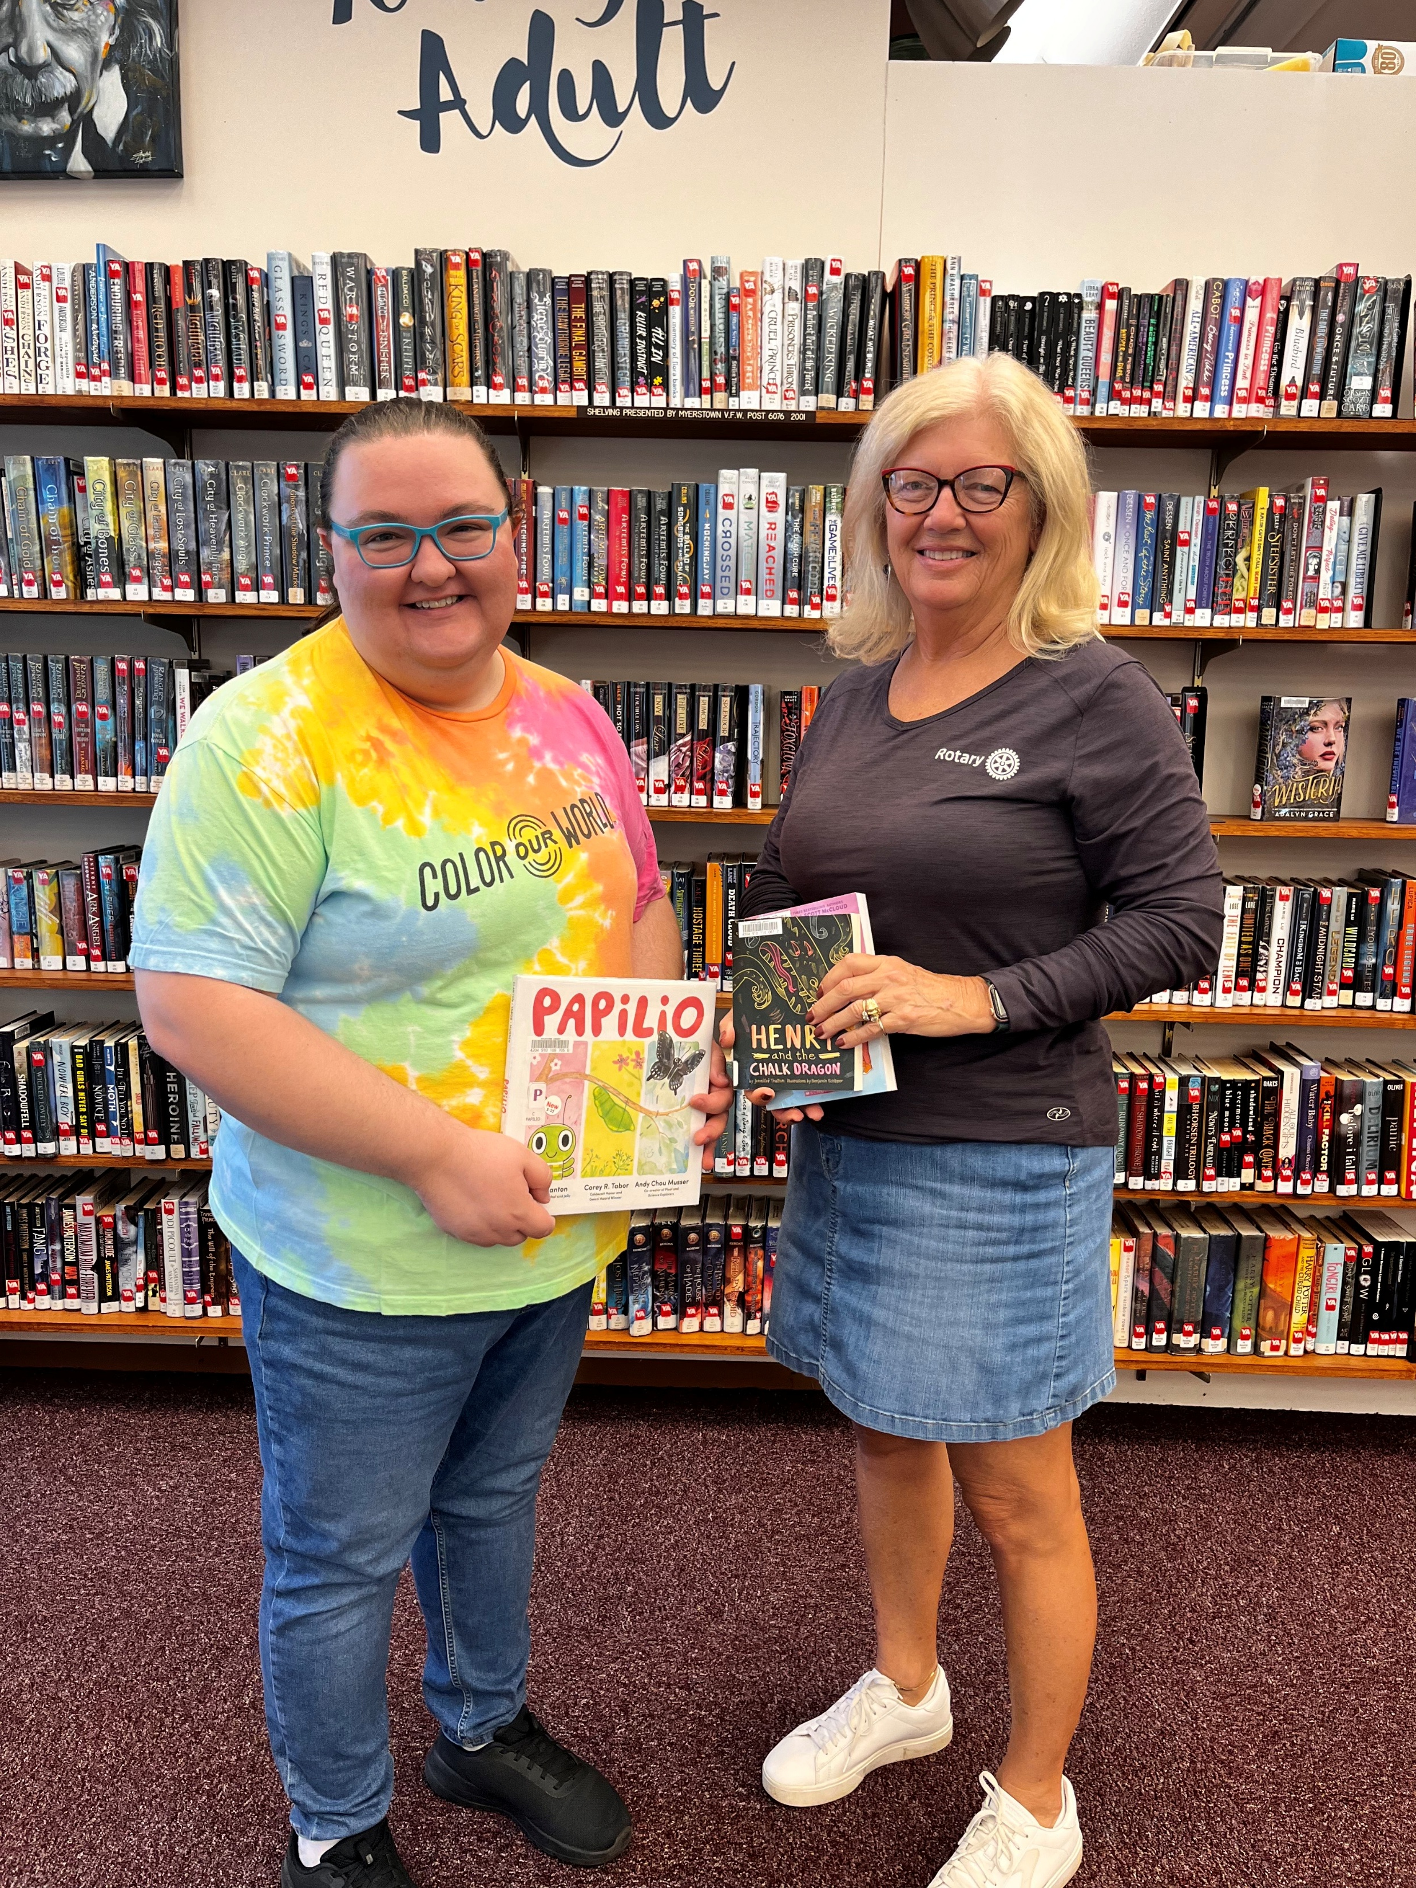
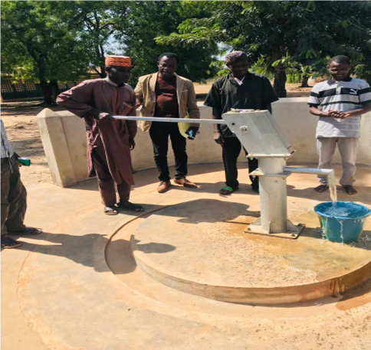
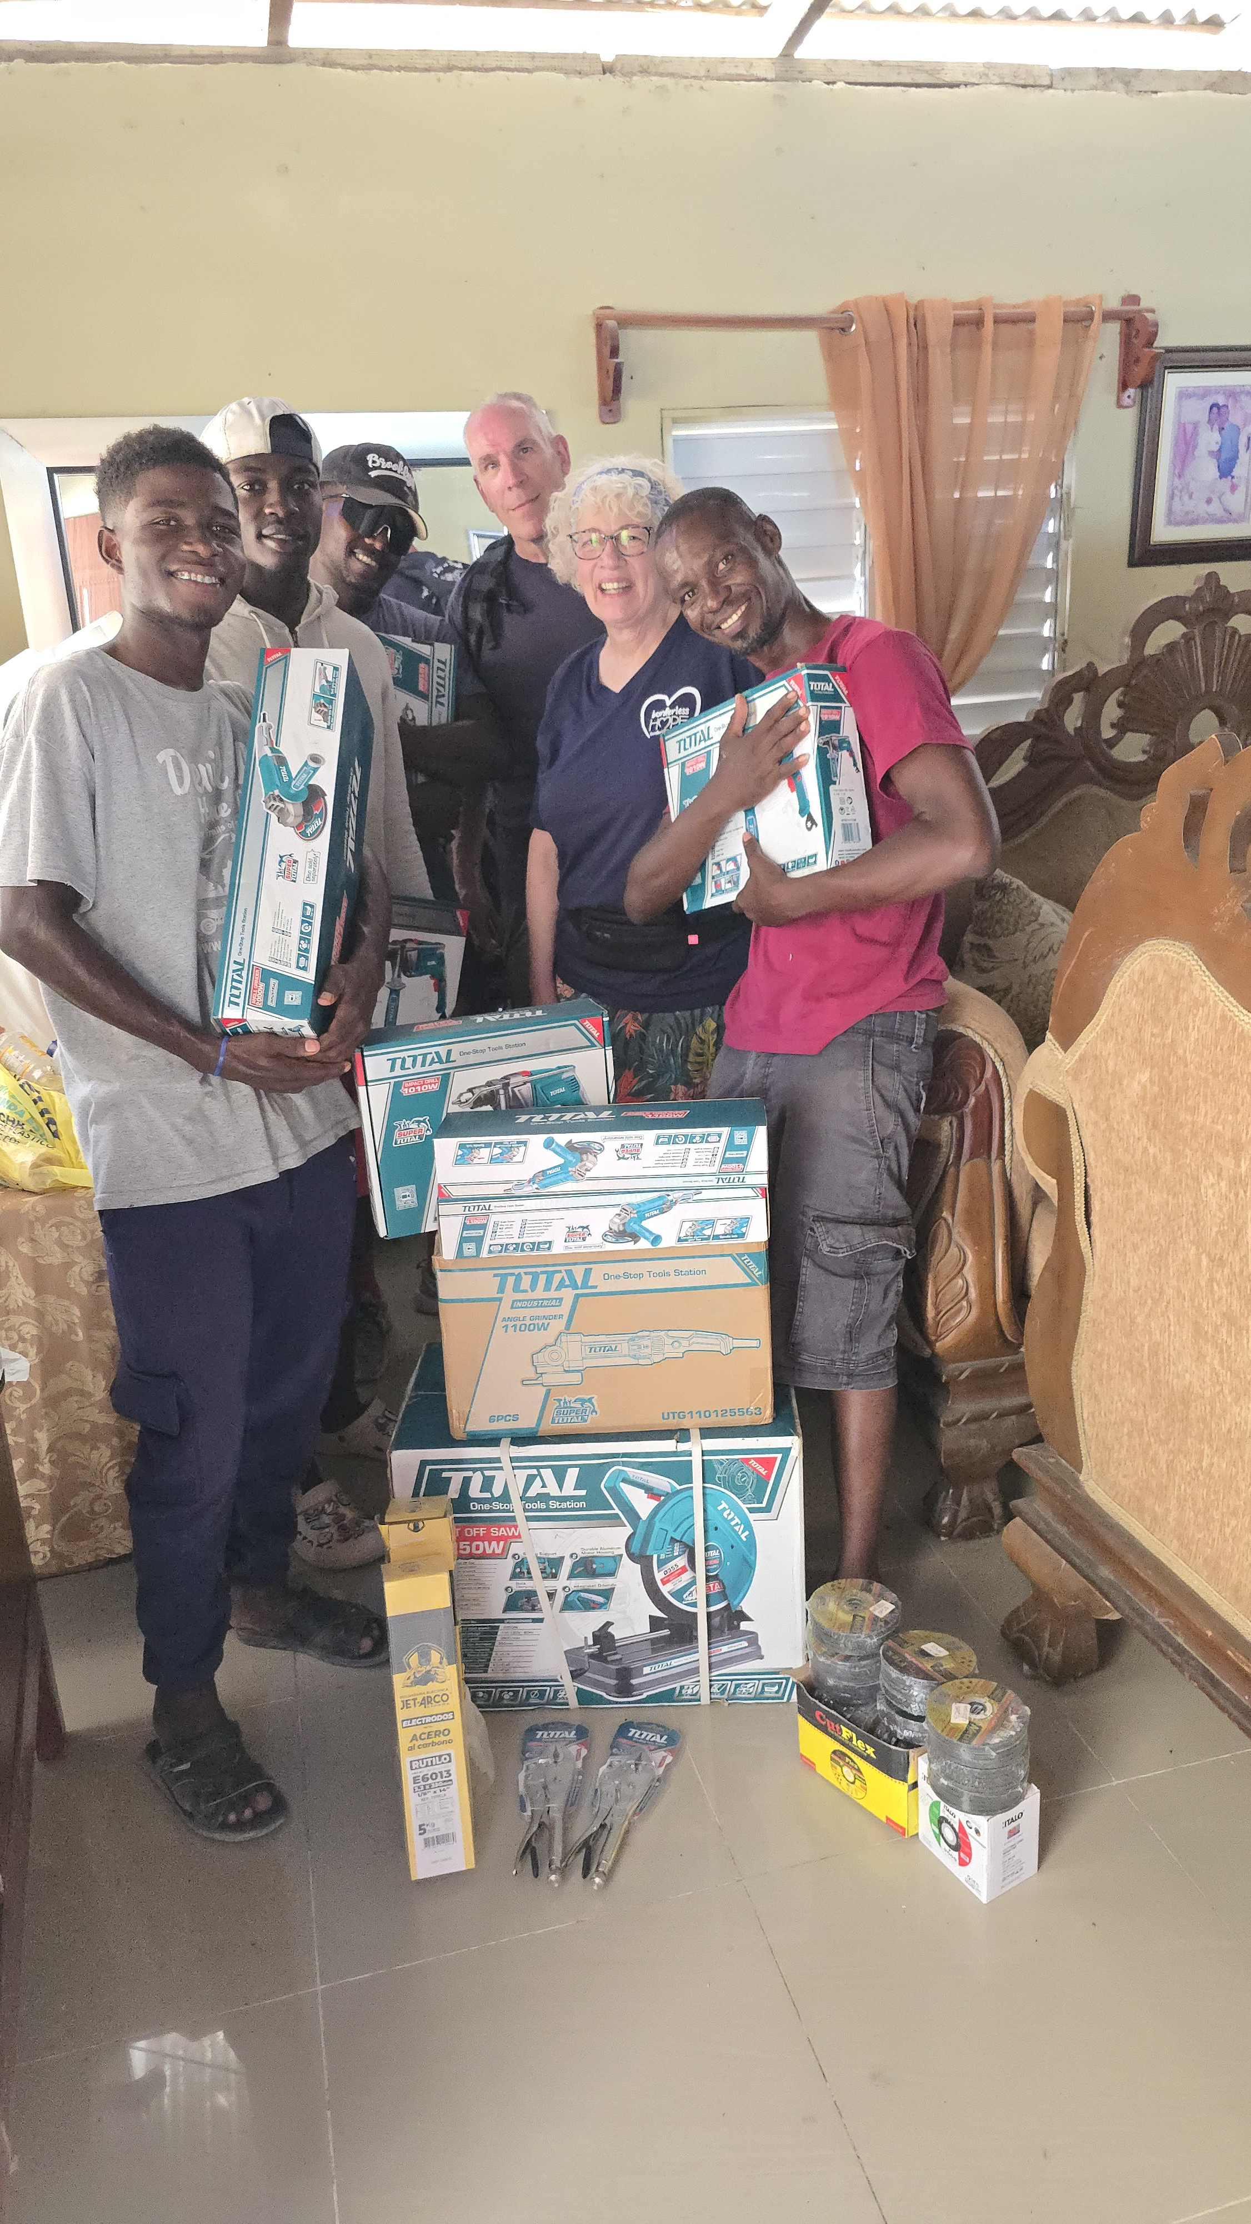
What Does Our Giving Make Possible?
Local Communities I Global Projects I Polio Eradication I Lasting Change
Title Page Option
Notes:
Tell ONE grant story – help presidents connect the Foundation with something tangible.

Slide 4
Where Does My Donation Go?
You
The Rotary Foundation
Grants & Rotary Impact
Annual Fund - SHARE
Some Rotary Foundation funds return to our district to support Rotary projects here at home.
Annual Fund-SHARE
District Designated Funds
World Fund
Title Page Option
Notes:
Giving helps create the resources that make Rotary projects possible. What you give today will be returned (in part) to the District

Slide 5
Three Ways to Make an Impact
Annual Fund-SHARE
Our primary annual giving priority
Supports Rotary’s work and future grant funding.
PolioPlus
Finish what Rotary started
The Gates Foundation contributes $2 for every $1 Rotary commits to polio eradication.
Endowment
Your Rotary legacy
Create lasting support for Rotary’s work.
Title Page Option
Notes:
Don’t overwhelm club members with every possible designation – If a Rotarian asks you, “Where should I start?” a simple answer can be the Annual Fund.

Slide 6
Every Gift Matters
Monthly Gift | Annual Impact
$10 | $120
$25 | $300
$50 | $600
$84 | ~$1000
Participation matters more than everyone giving the same amount.
Title Page Option
Notes:
Presidents shouldn't decide what their members can afford. The goal is to personally invite everyone to participate at a level meaningful to them.

Slide 7
Presidents: Build a Culture of Giving
You don’t need to become a Foundation expert.
You need to create opportunities for your members to connect with it.
During 2026-27:
Set and communicate your club’s Foundation goal
Personally invite every member to participate
Encourage recurring giving through Rotary Direct
Share Foundation impact stories throughout the year
Celebrate donor milestones
Identify members ready for Paul Harris Society or legacy giving
Title Page Option
Notes:
Remember, Foundation giving shouldn’t be one announcement during November. Clubs that regularly talk about impact are more likely to develop donors.

Slide 8
The Challenge: Invite Every Rotarian
Before our next President/AG Meeting in November:
Review your club’s current Foundation giving.
Confirm your 2026-27 Annual Fund goal.
Make your own personally meaningful gift.
Invite every member of your club to participate.
Our goal isn’t for every Rotarian to give the same amount. Our goal is for every Rotarian to understand the impact of The Rotary Foundation, be personally invited to give, and participate at a level meaningful to them.
Title Page Option
Notes:
Here are a few actionable steps you can take. Our goal isn’t for every Rotarian to give the same amount. Our goal is for every Rotarian to understand the impact of The Rotary Foundation, to be personally invited to give, and to participate at a level meaningful to them.

Slide 9
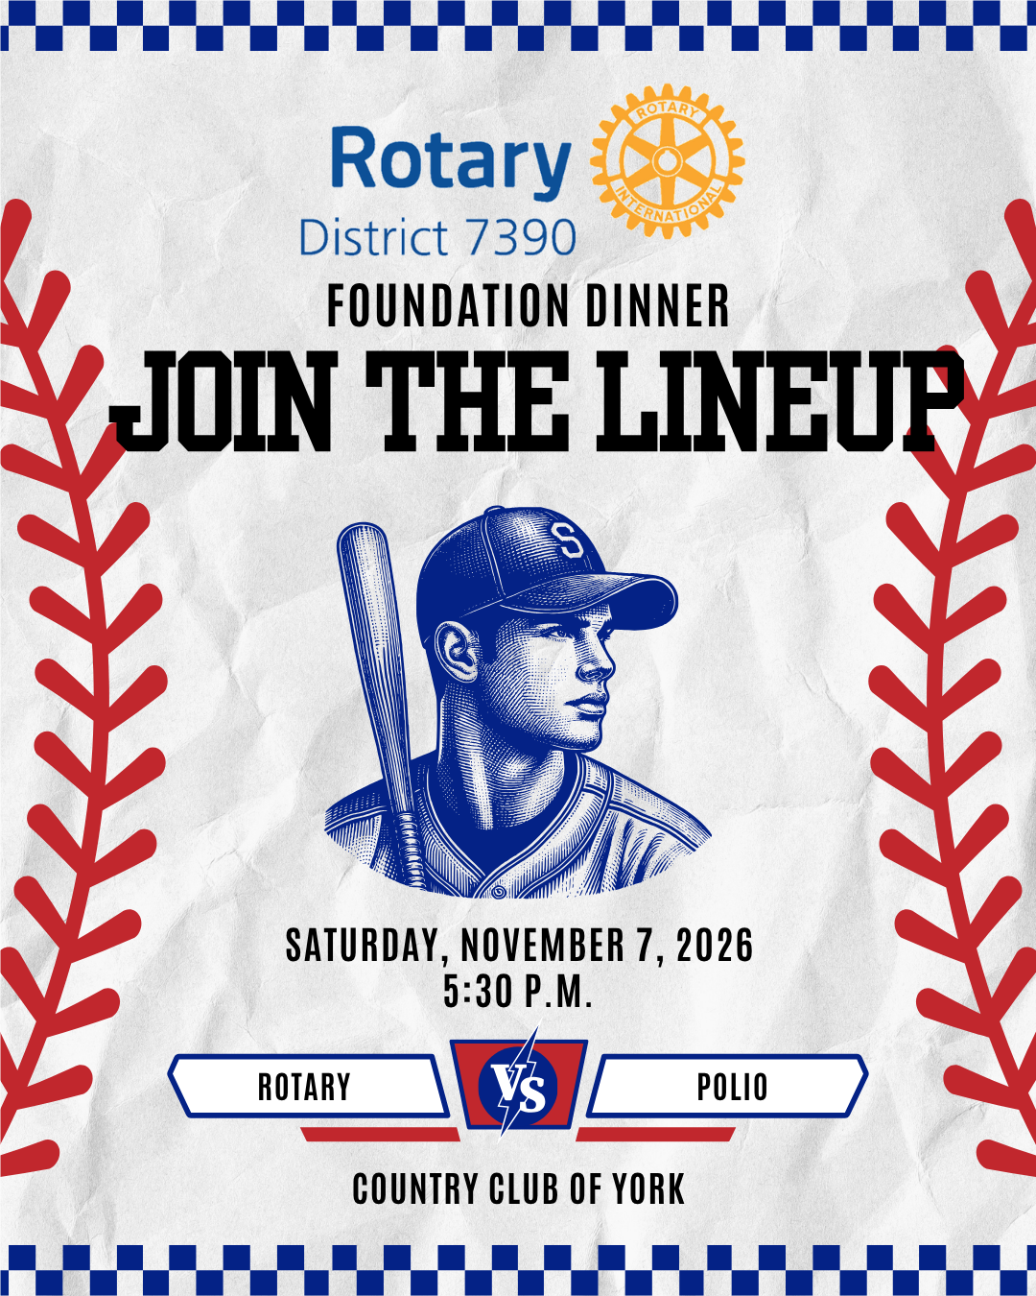
Foundation Dinner
Saturday, November 7, 2026 5:30-8:00pm
WHERE: Country Club of York
WHAT: Cocktail Reception, Dinner & Program
celebrating clubs and featuring keynote speaker, Rick White (President of the Atlantic League)
COST: $75
Title Page Option
Notes:
Join us as we celebrate what our generosity & support to The Rotary Foundation has allowed us to do in our communities locally and globally. Grants projects from 2025-26 were funded in part by donations made to TRF in 2022-23!

